Slide 1
INT247 Machine Learning Foundations
Class Exercise #1
Activation Functions & Error

Slide 2
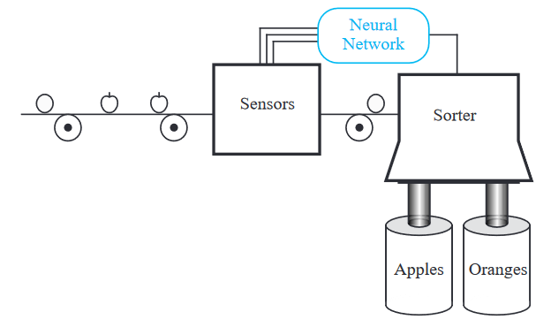
Exercise#1

Slide 3

Problem Statement
There are two different fruits
Apples
Oranges.
A produce dealer wants to sort the fruits according to three properties of the fruit:
Shape
texture
weight.

Slide 4
Sensor Outputs

Slide 5
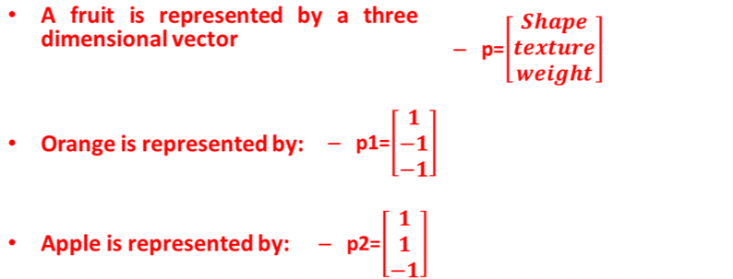

Problem Statement Cont…

Slide 6
Perceptron
Write a python program to do this classification using using perceptron. Consider weight matrix and bias as follows:
W= [0 1 0] and b=0
Test case 1
Shape=round, texture=rough, weight= 2 pound
Test case 2
Shape =elliptical, texture=smooth, weight= 2 pound
Use the following equation to compute the result:
Y=W.X+b, where W is weight, X is input and b is bias

Slide 7

Exercise#2
Analyze and criticize output with different weights and bias

Slide 8
Activation Functions Effects
It maps input to output in certain fashion.
There are many activation functions in machine learning:
Identity or linear activation function
Binary Step
Logistic or Sigmoid
Tanh
ArcTan
Rectified Linear Unit (ReLu)
Leaky ReLu

Slide 9
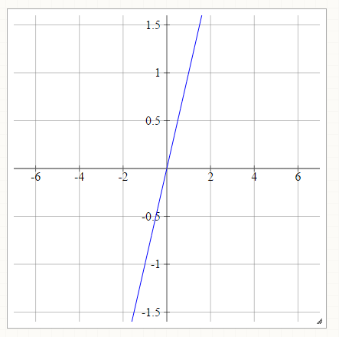
Identity or Linear Activation Function
f(x)=x
Input maps to same output

Slide 10
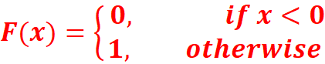
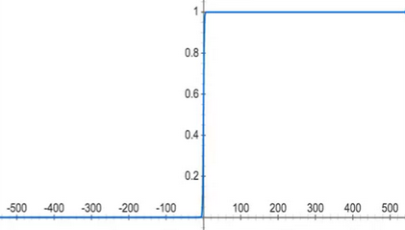
Binary Step
Very useful in Classifiers

Slide 11
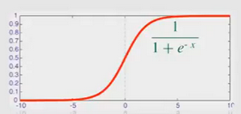
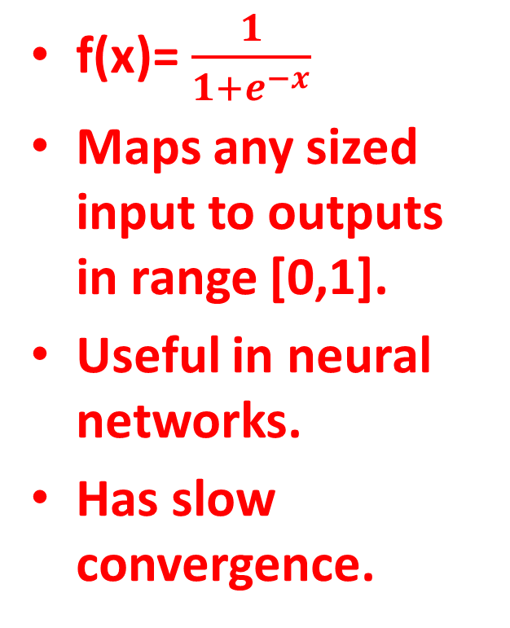
Logistic or Sigmoid
f(x)= $\frac{1}{1+e^{−x}}$
Maps any sized input to outputs in range [0,1].
Useful in neural networks.
Has slow convergence.

Slide 12
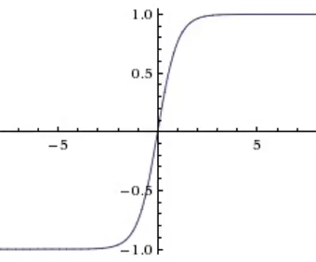
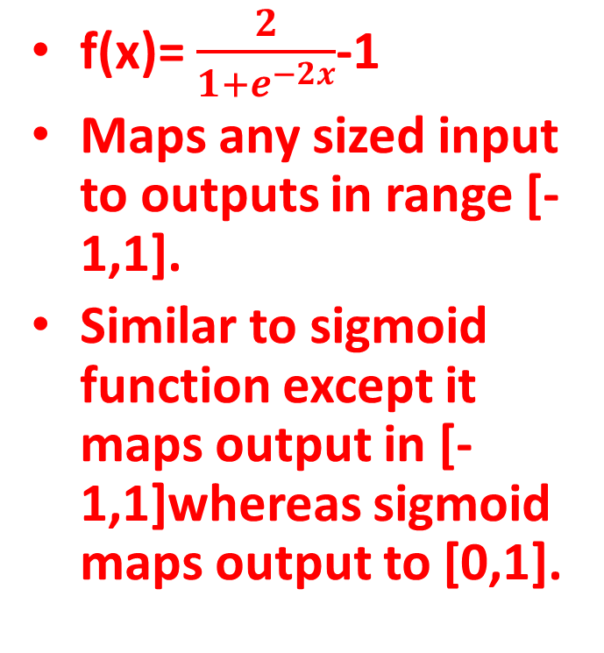
Tanh
f(x)= $\frac{2}{1+e^{−2x}}$-1
Maps any sized input to outputs in range [-1,1].
Similar to sigmoid function except it maps output in [-1,1]whereas sigmoid maps output to [0,1].

Slide 13
Tanh
f(x)= $\frac{2}{1+e^{−2x}}$-1
Maps any sized input to outputs in range [-1,1].
Similar to sigmoid function except it maps output in [-1,1]whereas sigmoid maps output to [0,1].

Slide 14
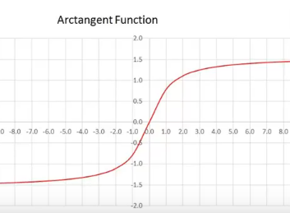
ArcTan
f(x)=tan⁻¹(x)
Maps input to output ranging between [-pi/2, pi/2].

Slide 15
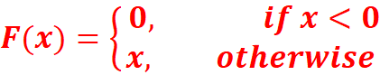
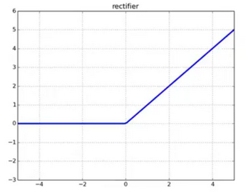
Rectified Linear Unit (ReLu)
It removes negative part of function
6 times improvement in convergence from Tanh function.
Limitation: only used in hidden layer of neural network

Slide 16
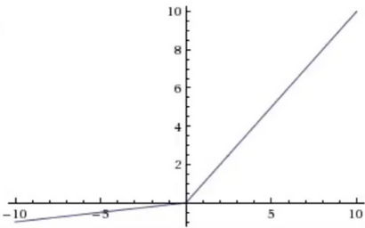
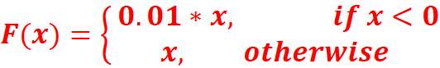
Leaky ReLu
The only difference between Relu and Leaky ReLu is it doesn’t completely vanishes the negative part, it just lowers its magnitude.

Slide 17
Exercise#3
Input :
x: a numpy array in range [1,10], with step size 0.1
w: a numpy array with equal size as X, with random integers from [-10, 10]
b: a random value in between [0, 1]
Output:
Output of different activation functions.
Plot the output values on activation functions using matplotlib for all activation functions.

Slide 18
Thank You !!!

